Slide 1

BIG MART SALES ANALYSIS
Name:- ABHISHEK

Slide 2

PROBLEM STATEMENT
In this research project
we will analyze the data of the company and will predict the
sales of the company. As Regression is an important machine
learning model for these kinds of problems. Thus we will solve the
regression problem

Slide 3
DATA AND SOURCES OF DATA:-
The data which was required for the project is collected from a Kaggle Dataset.
This dataset includes the information regarding BIgMart company’s items sales.

Slide 4
Step used in jupyter notebook To predict sales:-
1). Data cleaning.
2). Data Visualization.
3). Preprocessing task before model building.
a). label encoding.
b). splitting our data into train and test.
c). standardization.
d). model building.
4) Evaluation using Linear regressor.
5) Evaluation using random forest regressor.
6) Actual vs Predicted sales graph.

Slide 5

DATA VISUALIZATION

Slide 6
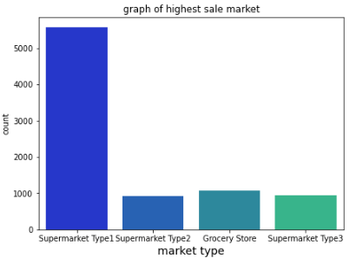
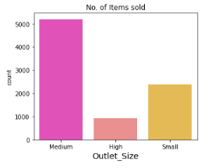
GRAPHS USING : MATPLOTLIB & SEABORN
MEDIUM SIZED ITEMS HIGHLY SOLD:
SUPERMARKET TYPE 1 :HIGHEST ITEMS

Slide 7
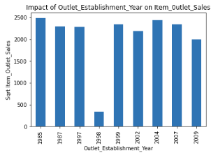
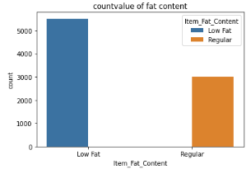
GRAPHS
Show no. of Item type in Item fat content
Outlet Establishment Year and Item Outlet Sales

Slide 8
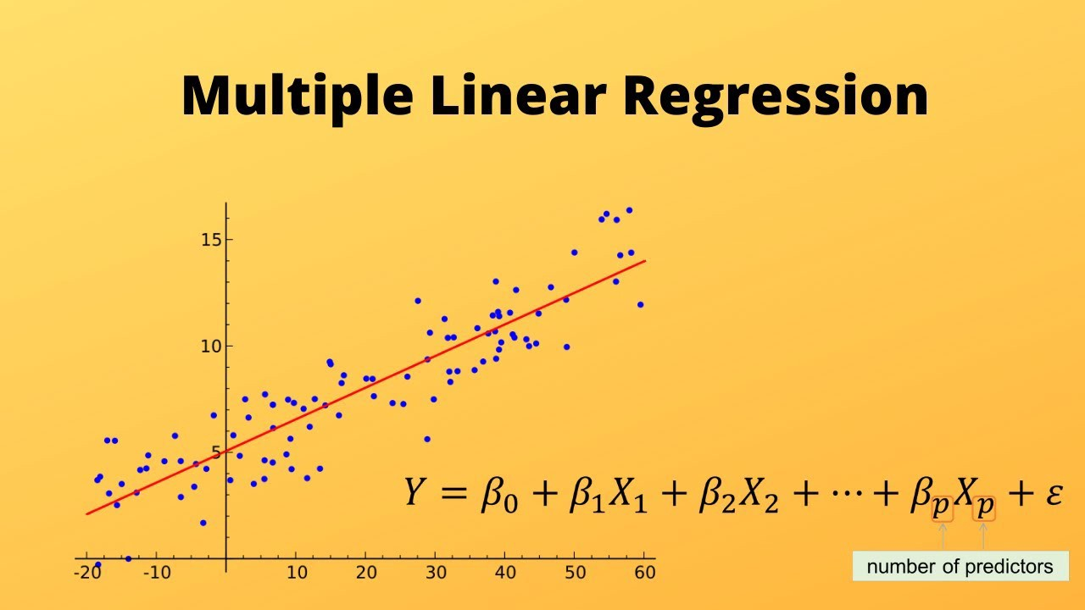
MACHINE LEARING TECHNIQUE USED:
MULTIPLE LINEAR REGRESSION

Slide 9
Linear regression
Linear regression is a supervised machine learning algorithm that is the most commonly used predictive analysis. This Regression model defines the relationship between the dependent as well as the independent variable. The dependent variable is also known as the response variable and can be denoted by X. The Independent variables are an input factor and are also known as the explanatory or predictor variables and can be denoted as Y in this case.evaluation by linear regression.
mean_absolute_error:- 477.9858904633177
r2_score:- 0.5829985235005208
RMSE value:- 599.4950981614279

Slide 10
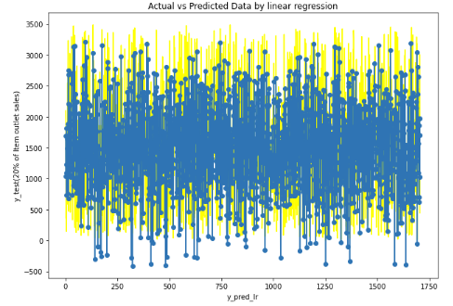
Actual vs Predicted Data by linear regression

Slide 11

RANDOM FOREST REGRESSOR

Slide 12
Random Forest
Random forest is a Machine Learning algorithm that is used for classification as well as regression problems. This ML algorithm combines multiple decision trees together to create a model that has high accuracy and more stability. Rather than depending on just one decision tree algorithm, the random forest takes the predicted outcome from each tree and also analyses the majority votes of predictions, and predicts the final output. Evaluation by Random forest.
mean_absolute_error:- 417.9643988269795
r2_score:- 0.6536310037610501
Rmse value:- 546.369371481759

Slide 13
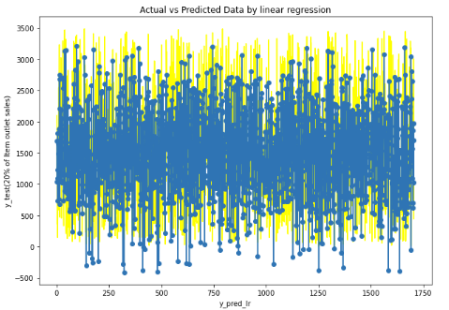
Actual vs Predicted Data by Random Forest

Slide 14
Some basic knowledge:-
1). R2_score:- R2_score is a statistical measure in a a regression model that determines the proportion of variance in the dependent variable that that can explained by the independent variable. In other words, r2_score shows how well the data fit the regression mode. The R2_score which is nearer to 1 is consider to be good.
2). Mean squared error(MSE):- MSE is used to check how close estimates or forecasts are to actual values. Lower the MSE, the closer is forecast to actual. MAE tells us how big of an error we can expect from the forecast on average.
3). Root mean squared error (RMSE):-Root mean squared error (RMSE) is the square root of the mean of the square of all of the error. It is considered an excellent general purpose error metric for numerical predictions. R-squared more than 0.75 is a very good value for showing the accuracy .If the RMSE for the test set is much higher than that of the training set, it is likely that you've badly over fit the data.

Slide 15

TOOL USED FOR ANALYSIS
POWER BI:

Slide 16
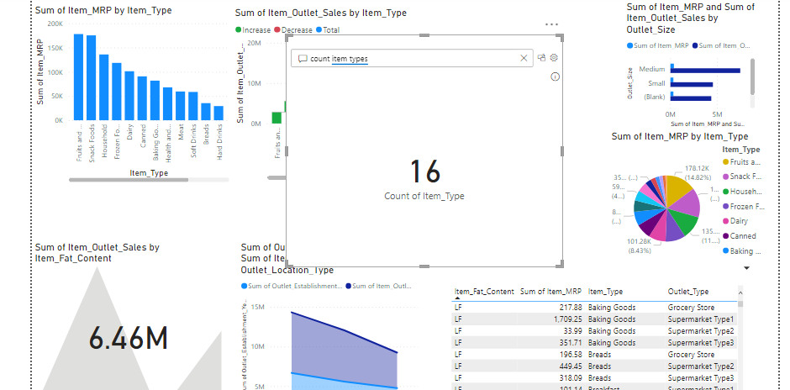
ANALYSIS USING POWER BI TOOL

Slide 17
RESULT
mean_absolute_error,r2_score ,root_mean_squared_error (RMSE):-
Name | r2_score | Root Mean Square Error (RMSE) value. | mean_absolute_error
Linear Regression | 0.5829985235005208 | 599.4950981614279 | 477.9858904633177
Random Forest | 0.6536310037610501 | 546.369371481759 | 417.9643988269795

